Slide 1
JavaScript Lab3
Dr. Wen-Tin Lee (李文廷)
Software Engineering and Management Department
National Kaohsiung Normal University

Slide 2
Lab 3-1 JavaScript onmousemove Event
在範例draw.html中，
增加清除的功能。當使用者按下alt鍵在滑鼠移動時設定table cell的background color為white
增加一個button，按下後可以清除整個畫圖視窗

Slide 3
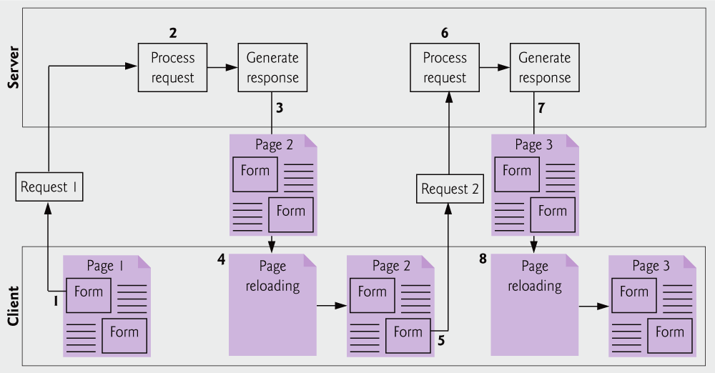
Classic web application reloading the page for every user interaction

Slide 4
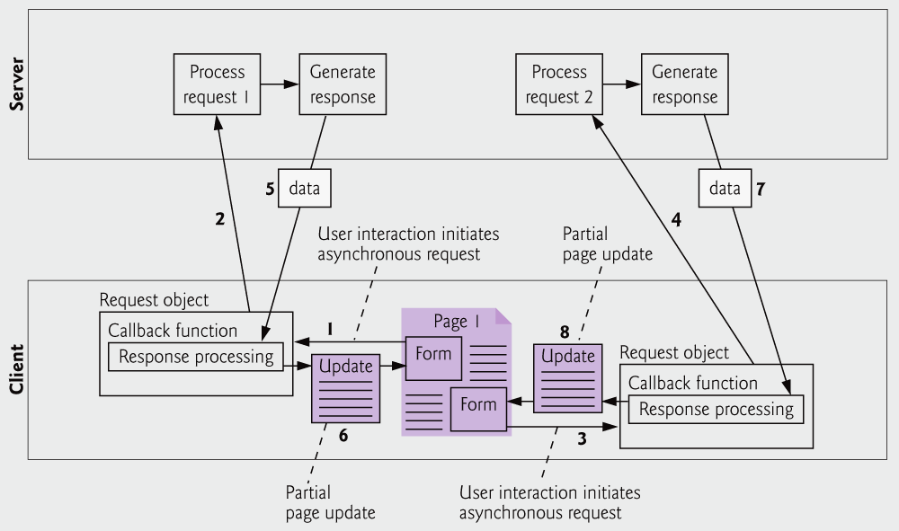
Ajax-enabled web application interacting with the server asynchronously

Slide 5
AJAX背後的技術
HTML/XHTML：主要的內文展示語言
CSS：為HTML提供樣式格式
DOM：動態地修改一個已載入的網頁文件
XML/JSON：資料交換格式
XSLT：將XML轉換為HTML（由CSS提供樣式）
XMLHttp：主要的溝通中間層
JavaScript：用來寫Ajax引擎的語言
ServerSide Scripting: PHP, Java Servlet/JSP, .NET

Slide 6
Google Instant
http://www.google.com/
下關鍵字的同時，可能的搜尋結果跟著出現

Slide 7
Gmail and Google Map
Gmail使用了多個frame和iframe來管理和儲存（cache）大型的使用者介面變更。用了這複雜的frame讓Gmail還是能順利運用[上一頁]和[下一頁]功能鍵
Google Map可以讓你直接用滑鼠往不同的方向拖拉移動地圖的位置。
這個地圖是由一組圖檔拼合在一起，來產生出一個連續影像的效果。

Slide 8
JSON
JSON (JavaScript Object Notation) is a lightweight data-interchange format.
based on a subset of the JavaScript Programming Language, Standard ECMA-262 3rd Edition - December 1999.
completely language independent
Two structures
A collection of name/value pairs (as an object, record, struct, dictionary, hash table, keyed list, or associative array).
An ordered list of values (as an array, vector, list, or sequence).

Slide 9
JSON and XML
{
"student": [
{
"id":"01",
"name": "Tom",
"lastname": "Price"
},
{
"id":"02",
"name": "Nick",
"lastname": "Thameson"
}
]
}
<?xml version="1.0" encoding="UTF-8" ?>
<root>
<student>
<id>01</id>
<name>Tom</name>
<lastname>Price</lastname>
</student>
<student>
<id>02</id>
<name>Nick</name>
<lastname>Thameson</lastname>
</student>
</root>
https://json.org/example.html

Slide 10
Key Difference between JSON and XML
JSON object has a type whereas XML data is typeless.
JSON types: string, number, array, Boolean
All XML data should be string
JSON does not provide namespace support while XML provides namespaces support.
JSON has no display capabilities whereas XML offers the capability to display data.
JSON supports only UTF-8 encoding whereas XML supports various encoding formats.

Slide 11
Passing Data with JSON1
One major drawback of XML is speed.
XML requires two tags per data point, plus extra tags for parent nodes and so on.
All this extra data in transmission slows down the data exchange between the client and server.
We can use JSON (pronounced Jason) instead.
JSON objects are typically smaller than the equivalent XML documents.

Slide 12
Passing Data with JSON2
JavaScript eval()
在JSON資料提供站台與使用站台都屬於可信賴時並不會有問題。但如果資料提供站台不在信任範圍內，將JavaScript程式碼嵌入JSON，則會造成安全上的問題。
透過parseJSON()讀取JSON資料，parseJSON採用解析器驗證讀入的代碼是否真的是JSON代碼，提供了較好的安全性。

Slide 13
Passing Data with JSON3
JSON.parse (text)
var obj = JSON.parse(‘{“name”:”Tim”, “age”:30, “city”:”Kaohsiung”}’);
JSON.stringify(json object)
var myJSON = JSON.stringify(obj);

Slide 14
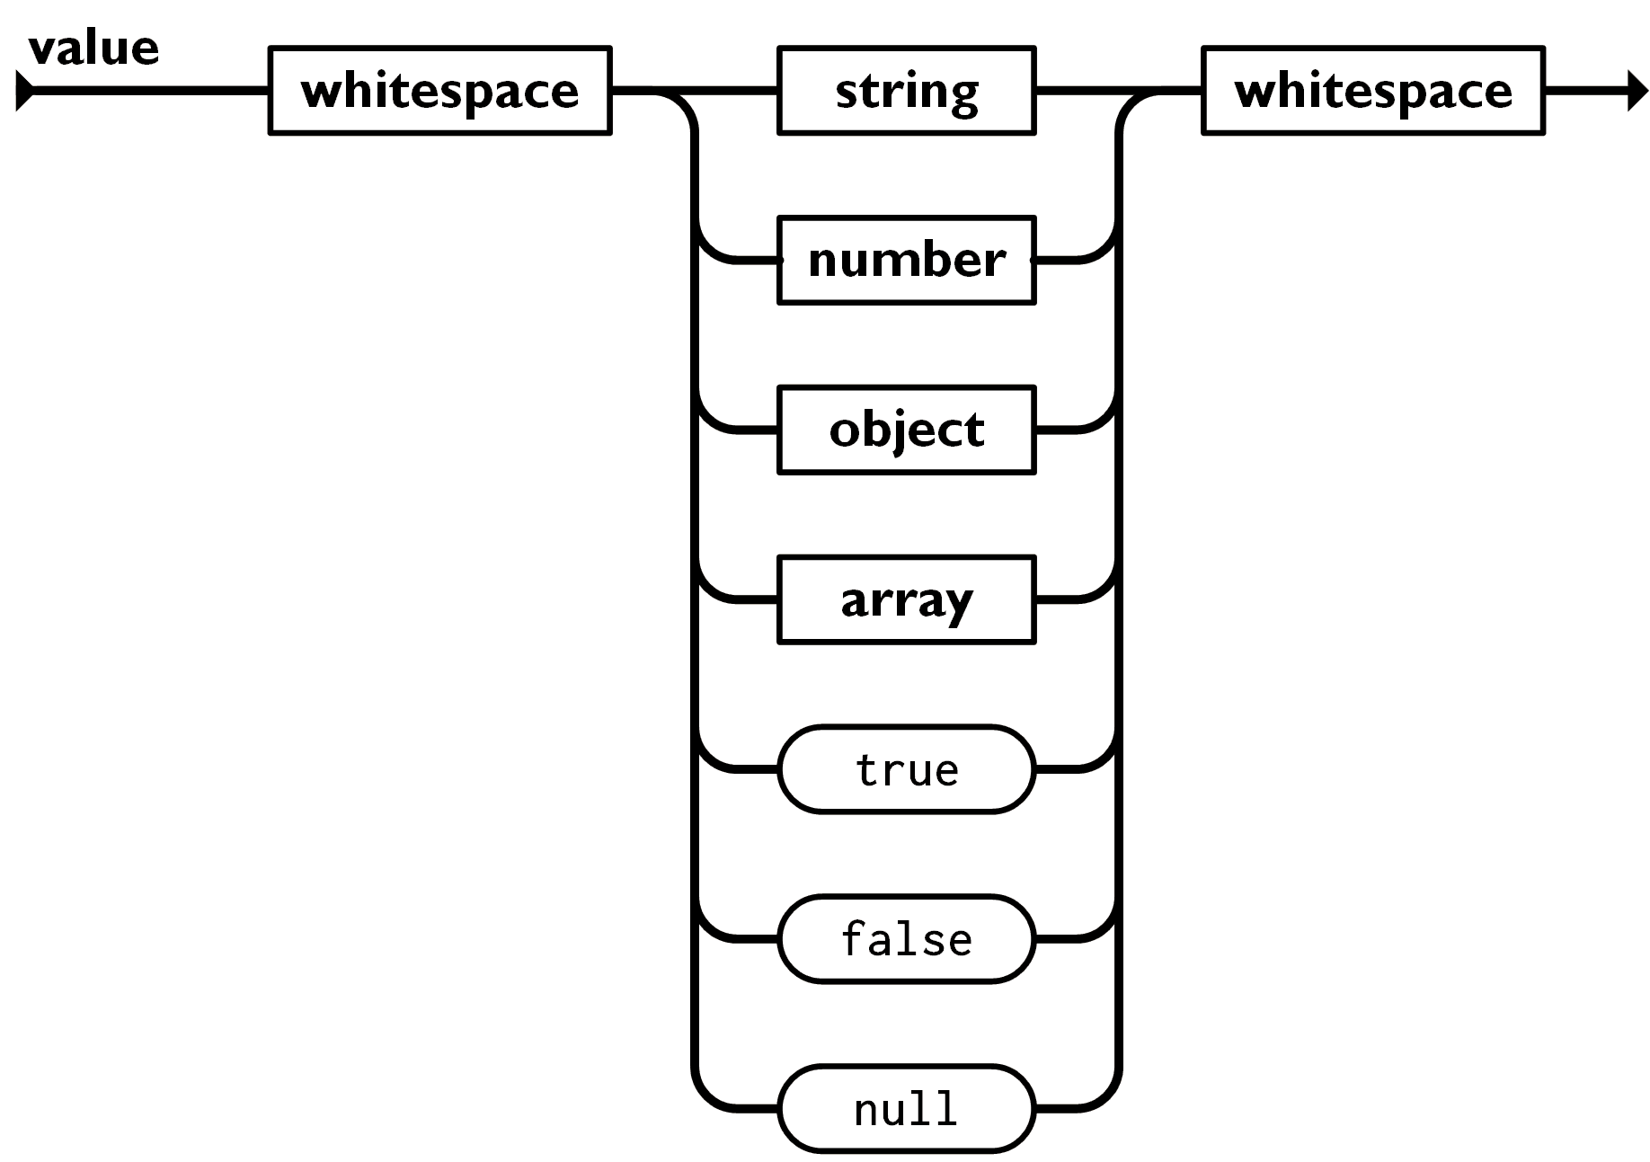
JSON: Values
Strings
Numbers
Booleans
Objects
Arrays
null

Slide 15
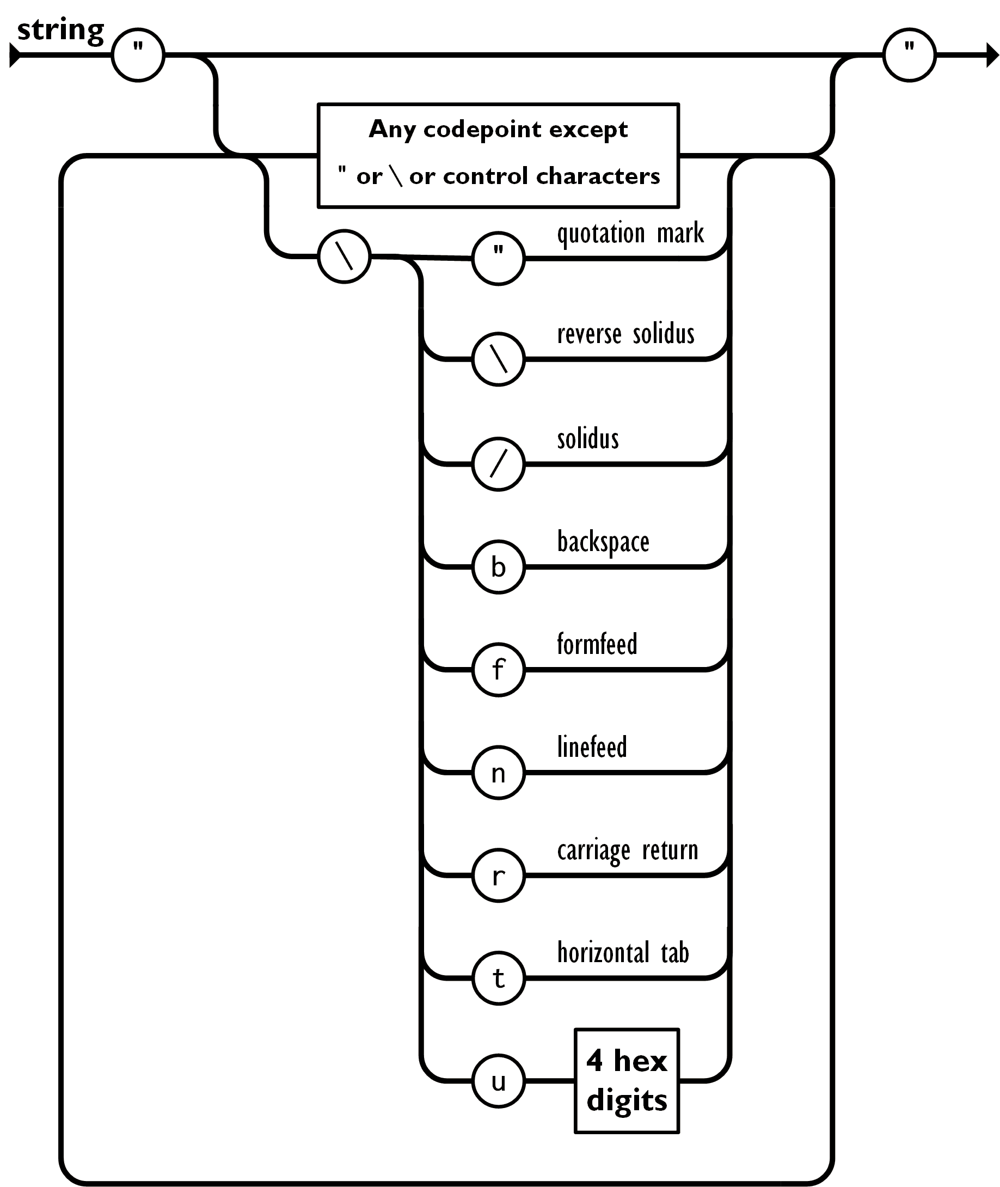
JSON: Strings
Sequence of 0 or more Unicode characters
No separate character type
A character is represented as a string with a length of 1
Wrapped in "double quotes"
Backslash escapement
Syntax:
var json-object-name = { string : "string value",…..}
Example:
var obj= {name: 'Andy'}

Slide 16
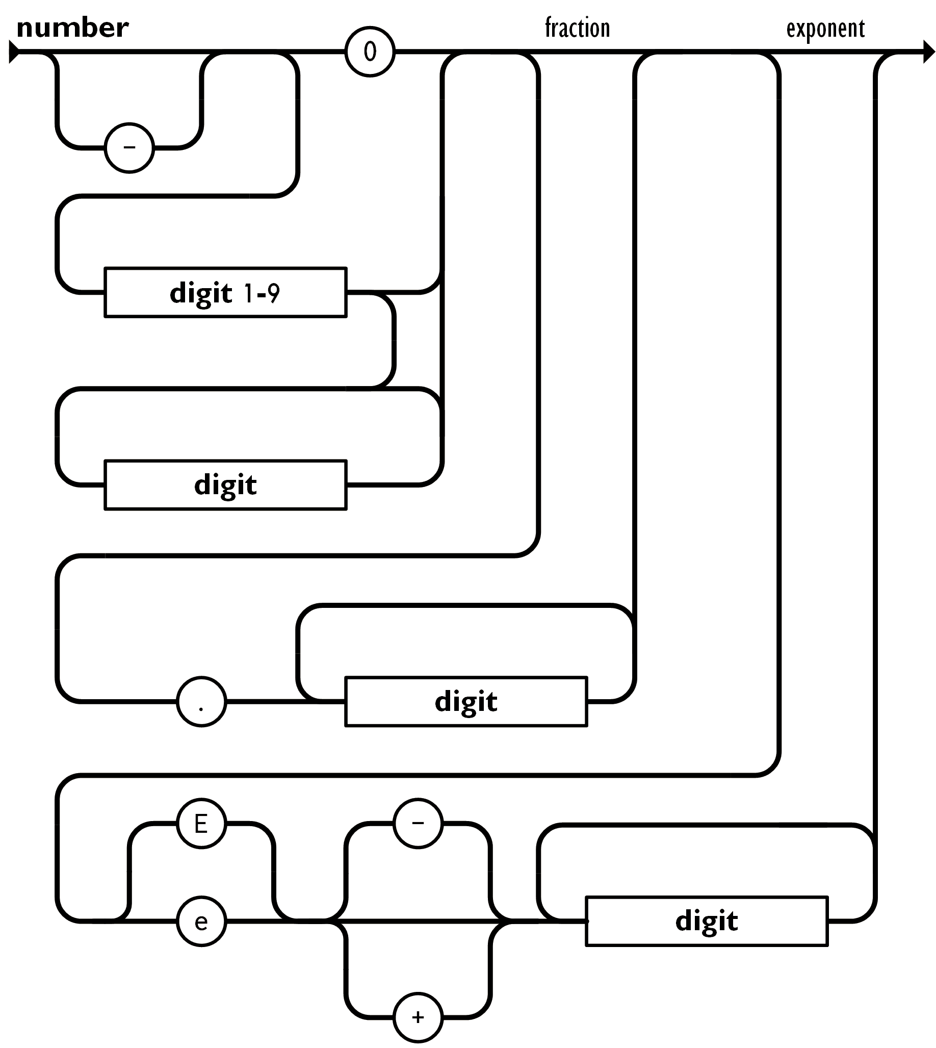
JSON: Numbers
Integer
Real
Scientific
No octal or hex
No NaN or Infinity
Use null instead
Syntax:
var json-object-name = { string : number_value,......}
Example:
var obj = {salary: 2600}

Slide 17
JSON: Booleans
true
false
Syntax:
var json-object-name = {string : true/false, …..}
Example:
var obj = {active: 'true'}

Slide 18
JSON: null
A value that isn't anything
Syntax:
var json-object-name = {string : null, …..}
Example:
var obj = {active: null}

Slide 19
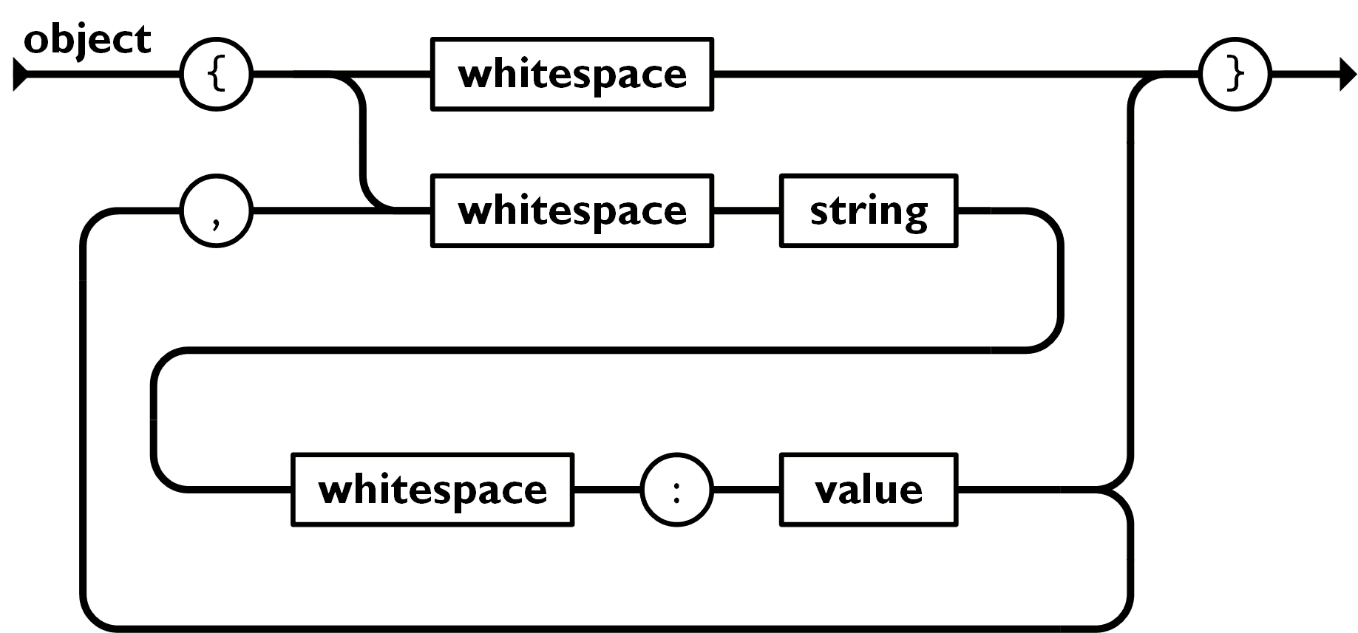
JSON: Object
Objects are unordered containers of key/value pairs
Objects are wrapped in { }
, separates key/value pairs
: separates keys and values
Keys are strings
Values are JSON values

Slide 20
JSON: Object
{
"name": "Jack B. Nimble",
"at large": true,
"grade": "A",
"format": {
"type": "rect",
"width": 1920,
"height": 1080,
"interlace": false,
"framerate": 24
}
}
Syntax:
{ string : value, ….. }
Example:
{ "id": 110, ‬‬‬‬‬‬‬‬‬‬‬‬‬‬‬‬‬‬‬‬‬‬ "language": "Python", "price": 1900, }

Slide 21
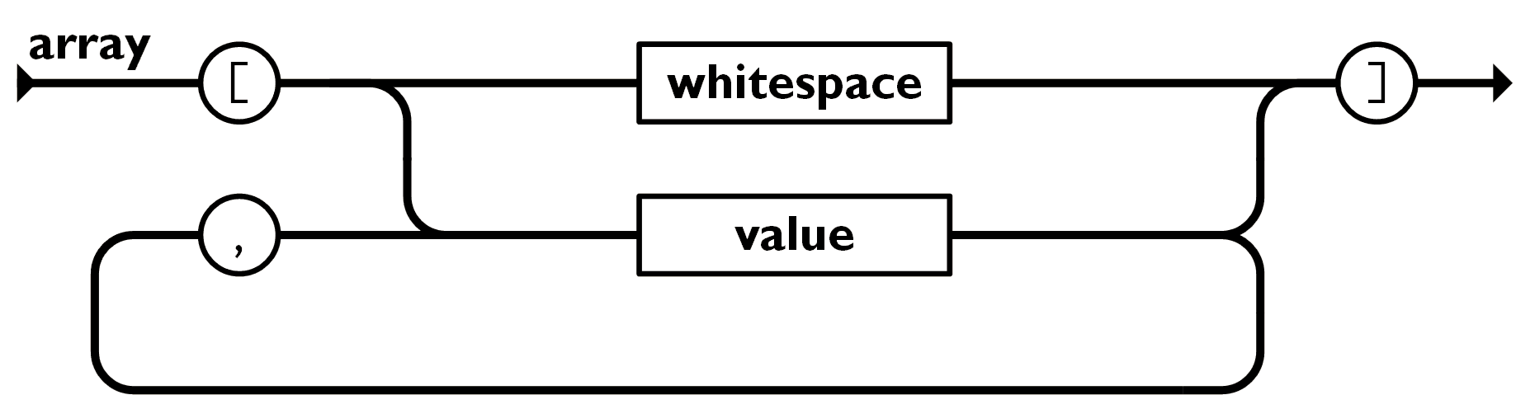
JSON: Array
Arrays are ordered sequences of values
Arrays are wrapped in []
, separates values
JSON does not talk about indexing.
An implementation can start array indexing at 0 or 1.
Syntax:
[value, .......]

Slide 22
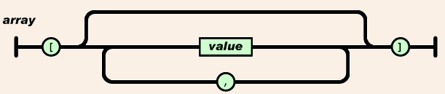
Array
["Sunday", "Monday", "Tuesday", "Wednesday", "Thursday", "Friday", "Saturday"]
[
[0, -1, 0],
[1, 0, 0],
[0, 0, 1]
]

Slide 23
Lab 3-2 JSON object for Ajax
撰寫一個shoppingCart json 物件，此物件包含
customerName:Bill,
customerEmail: bill@example.com,
orderID:123456,
shoppingList陣列包含兩個product物件，分別為{productID: 12, productName:iPad, quantity:1}, {productID: 28, productName:HTC IS, quantity:2}，
最後剖析(parse)此物件，將此購物車資訊列於網頁上

Slide 24
Reference
W3C JavaScript tutorial
http://www.w3schools.com/js/default.asp
W3C HTML DOM tutorial
http://www.w3schools.com/htmldom/dom_intro.asp
The Computer Technology Documentation Project
http://www.comptechdoc.org/independent/web/cgi/javamanual/index.html

